Slide 1
Investigating spatiotemporal patterns and validation techniques using high resolution NO₂ data
Los Angeles, CA
June 26th, 2017
Pandora statistics, sensitivity to spatial resolution and diurnal insights
Laura Judd, NASA LaRC/USRA Jay Al-Saadi, NASA LaRC
6th TEMPO Science Team Meeting, June 6-7 2018, Boulder, CO

Slide 2
GeoTASO and GCAS Airborne Instruments
Courtesy Scott Janz (NASA), Caroline Nowlan (SAO)
GeoTASO = Geostationary Trace gas and Aerosol Sensor Optimization
GCAS = GEO-CAPE Airborne Simulator
NASA test-bed instruments for geostationary missions
Provide test data
Satellite analogues for field campaigns
Future validation instruments
Trace gas footprint at surface is ~250 m × 250 m (NO₂) to 1 km x 1 km (SO₂)

Slide 3
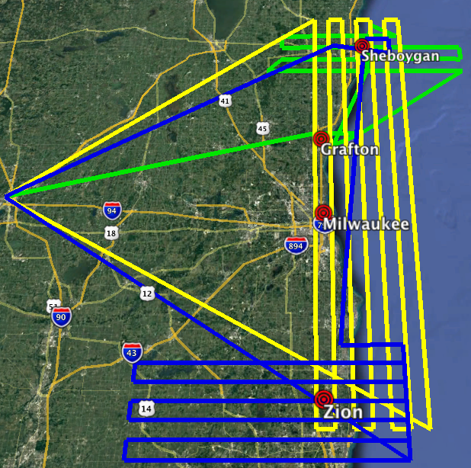
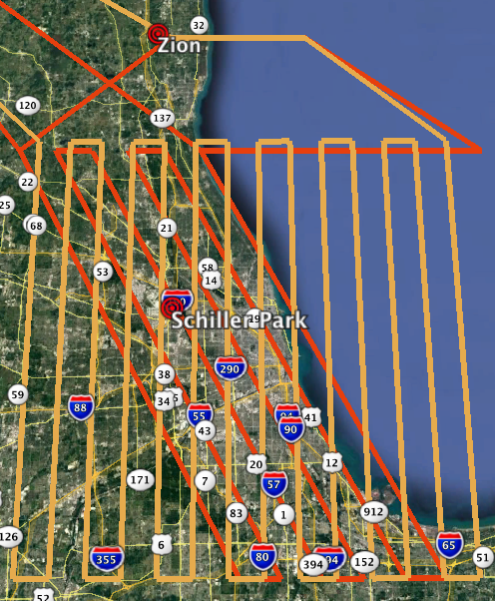
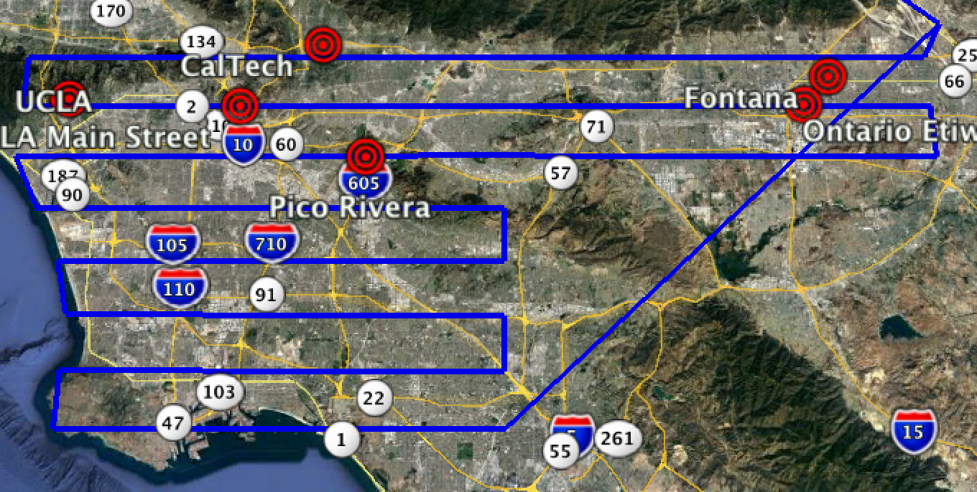
Flight strategy accomplishments
Flight plans playbook for LMOS/SARP 2017
Gapless maps (Rasters) were built to cover an area of interest by spacing parallel flight legs 6 km apart, allowing for overlap between swaths
This strategy started with DISCOVER-AQ Denver in 2014, evolved through KORUS-AQ 2016, LMOS 2017, SARP 2017, and will continue with LISTOS 2018 this summer.
With these flights, we have gained:
Diurnal insights on the temporal patterns of NO₂ in urban/polluted regions with repeated samplings over the period of one day: (i.e. Seoul and Los Angeles)
Coincident overpasses of Pandora Spectrometers with which to assess airborne-based retrievals and test validation strategies
Ability to scale to coarser spatial resolutions to see how the results are influenced by spatial sampling and offsets
Notes:
List is the order I plan to talk about things

Slide 4
Diurnal Insights: Seoul, South Korea, June 9th 2016
NO₂ Tropospheric Slant Column
Pandora Diurnal Profiles
Over the Seoul Metropolitan area, NO₂ accumulates throughout the daytime hours on June 9th, 2016.
Terrain and meteorology play big roles in diurnal patterns
The diurnal patterns vary greatly from site-to-site and day-to-day
Judd et al., 2018 (in review)
Notes:
Rasters 1 and 3 includes wind vectors averaged through the lowest 500 m agl from the full resolution Global Data Assimilation System (GDAS) at (a) 00:00 UTC (09:00 LT) and (c) 06:00 UTC (15:00 LT).

Slide 5
Diurnal Insights: Seoul, South Korea, June 9th 2016
Pandora hourly-averaged NO₂ Vertical Column during 6-week KORUS-AQ campaign
Terrain and meteorology play big roles in diurnal patterns
The diurnal patterns vary greatly from site-to-site and day-to-day
Judd et al., 2018 (in review)
Notes:
Rasters 1 and 3 includes wind vectors averaged through the lowest 500 m agl from the full resolution Global Data Assimilation System (GDAS) at (a) 00:00 UTC (09:00 LT) and (c) 06:00 UTC (15:00 LT).

Slide 6
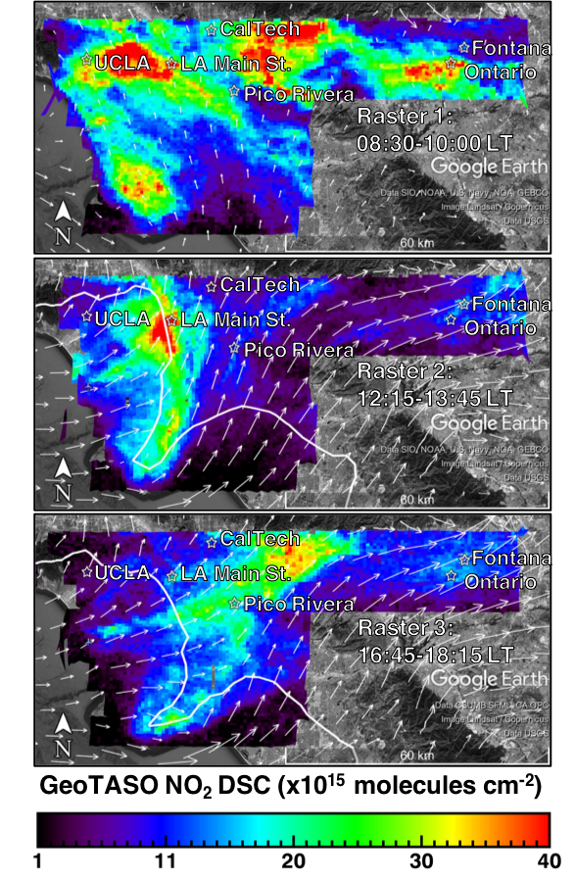
Diurnal Insights: Los Angeles, June 27th, 2017
Like Seoul, early morning maps exhibit features similar to expected emission sources (roadways, LAX airport) in the presence of weak near-surface winds.
Unlike Seoul, NO₂ decreases throughout the day in the LA Basin.
At these high spatial resolutions, we are capturing the signatures of fresh emission sources in the morning and the interaction of features linked to meteorology (i.e. sea breeze front moving inland and converging in the LA Basin (Raster 2 and 3).
Other diurnal cases include Denver, CO in 2014, Chicago, IL in 2017 and NYC Summer 2018.
Other temporal insights: day-to-day variability in the magnitude of NO₂ depending on day of week and prevailing meteorology patterns.
Judd et al., 2018 (in review)
Notes:
Overlaid are the boundary layer averaged wind vectors from the NAM-CONUS 3-km nest analysis for 16:00 UTC (09:00 LT), 20:00 UTC (13:00 LT), and 00:00 UTC (17:00 LT).

Slide 7
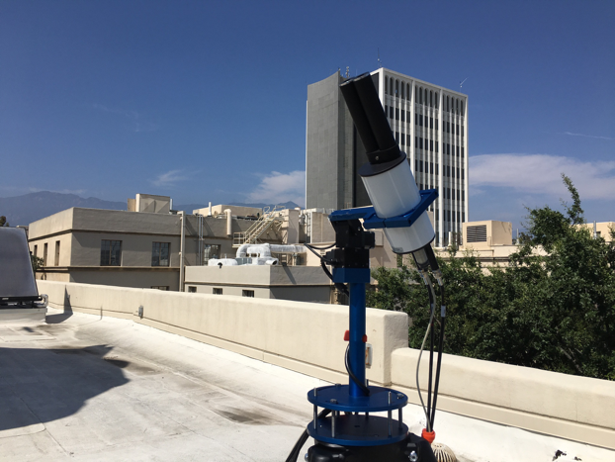
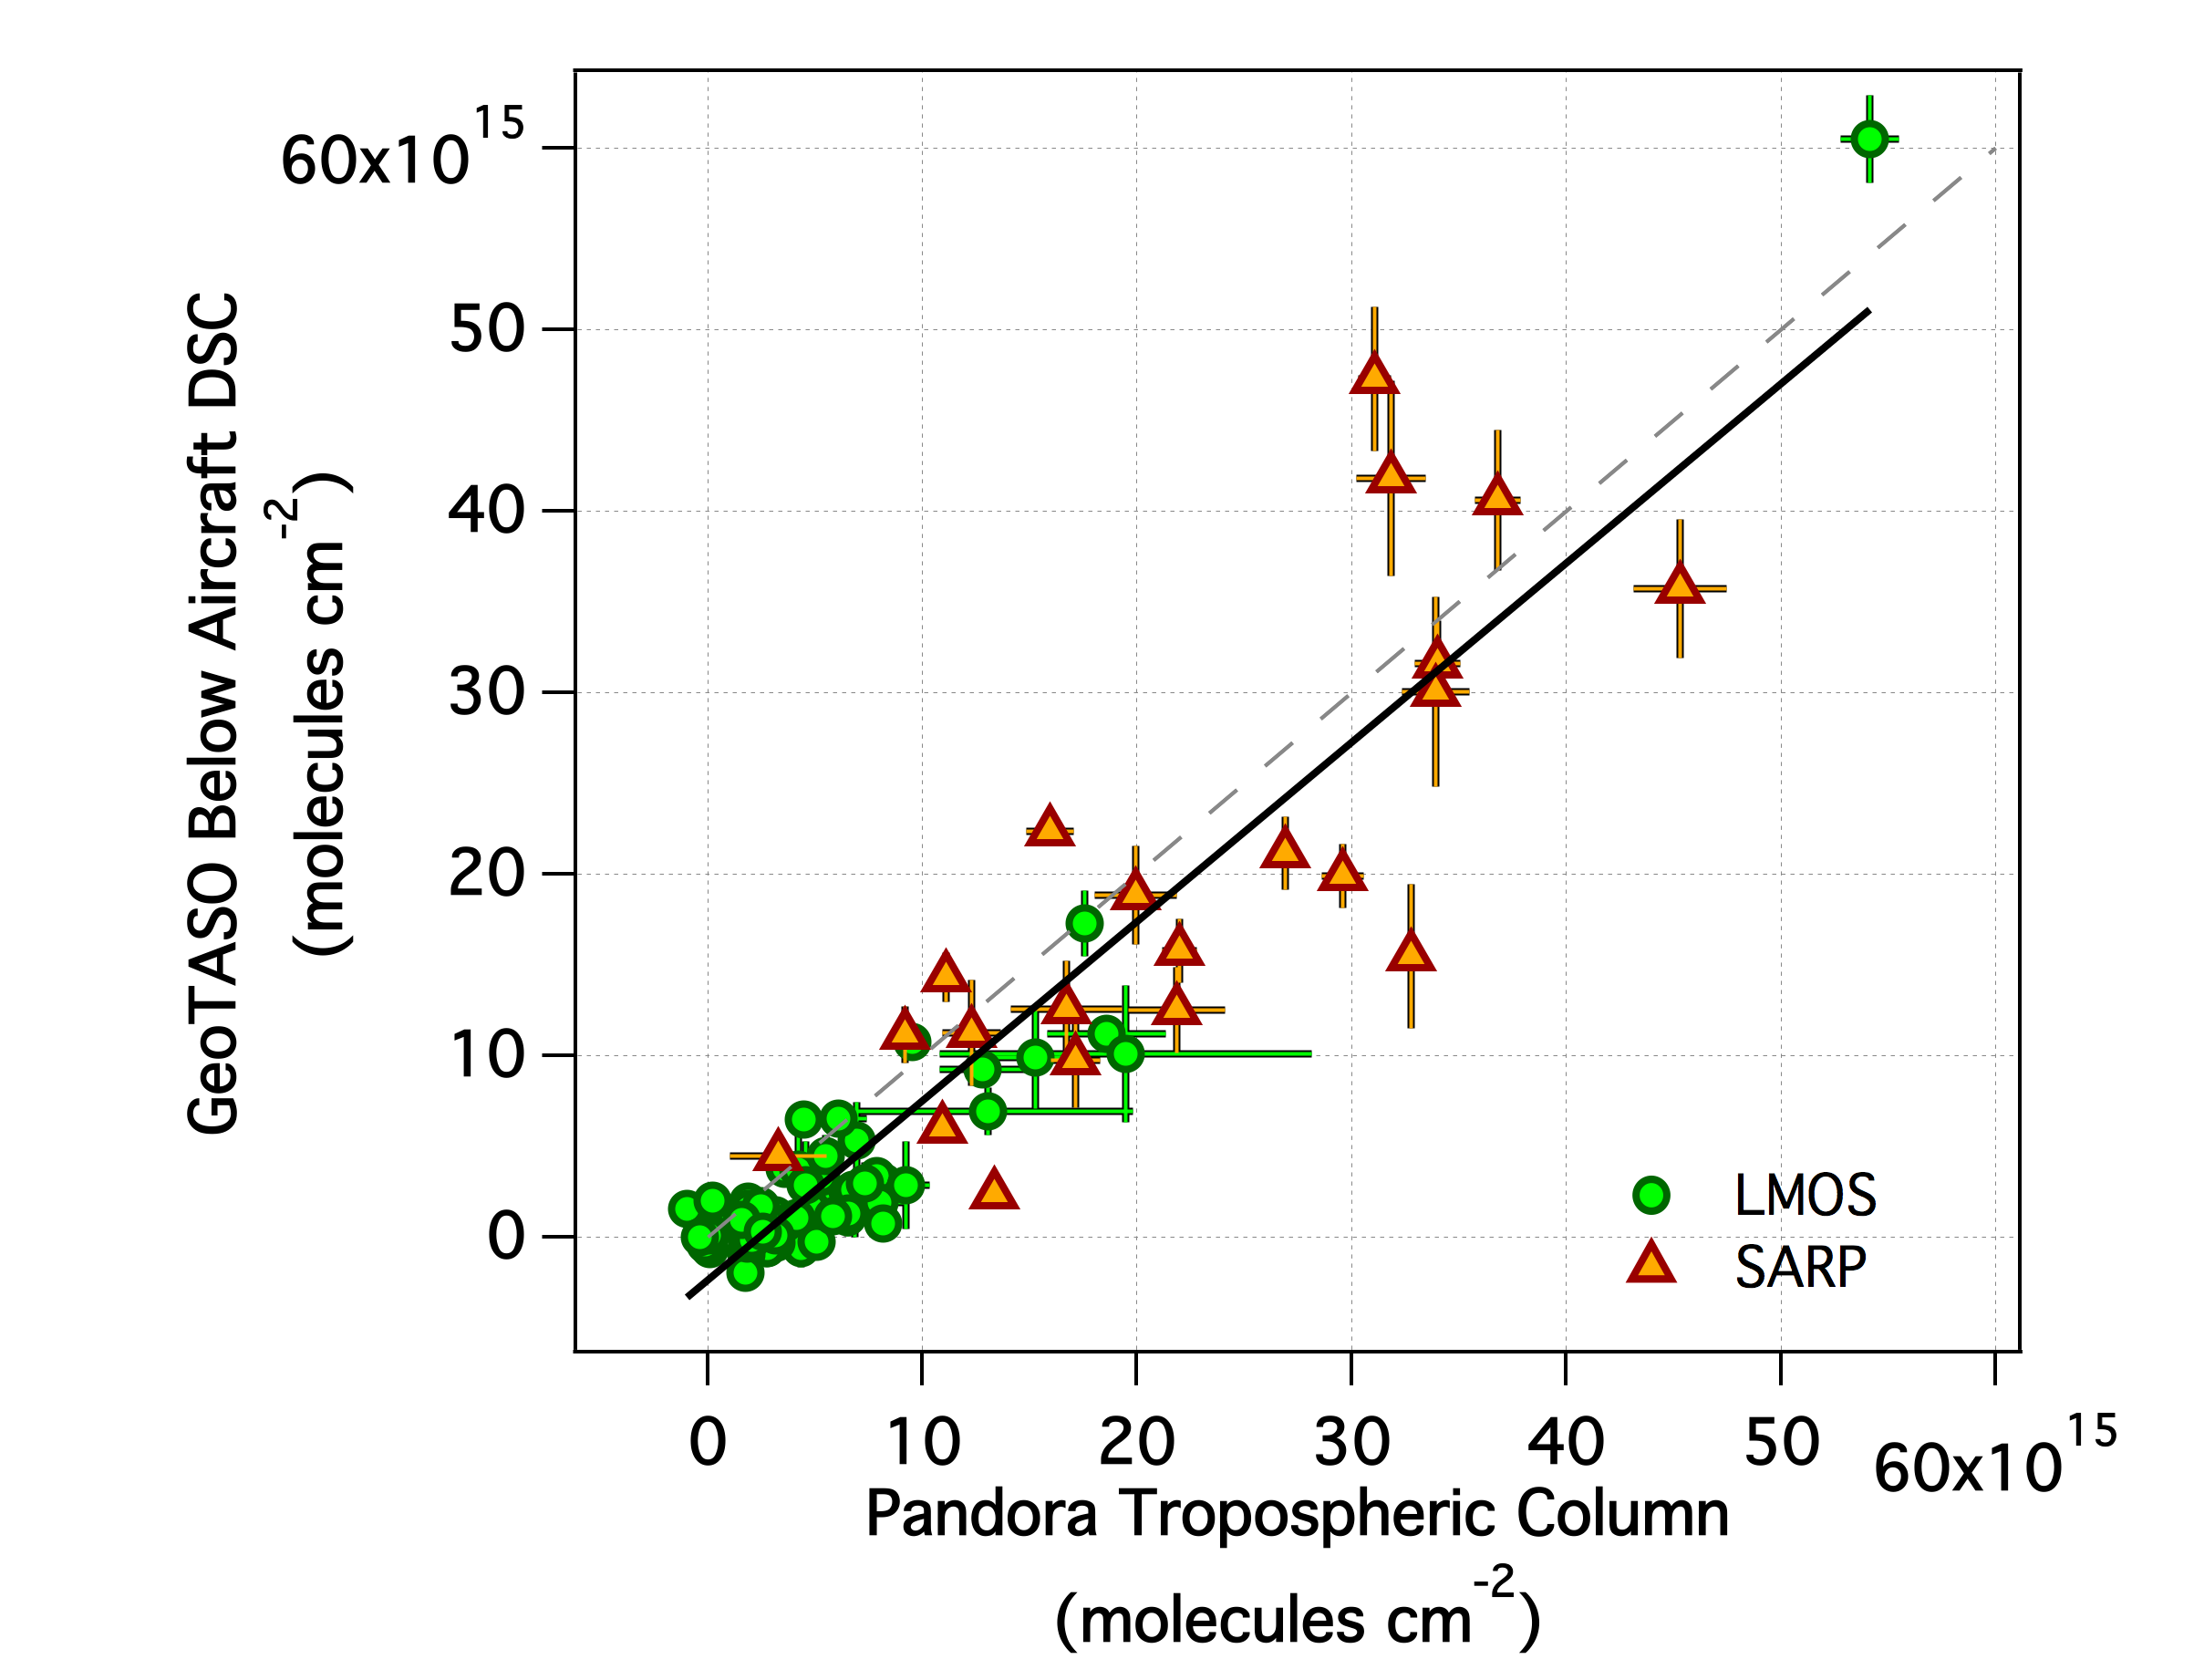
Pandora Spectrometer Coincidences [LMOS and SARP 2017]
Pandora is a ground-based spectrometer capable of retrieving NO₂ columns via direct-sun DOAS.
The Stratospheric Column was estimated and subtracted from both datasets to make a a closer apples-to-apples comparison of tropospheric slant columns. [Datasets used include OMI, OMPS, and PRATMO Chemical Box Model]
y=0.99x-2.4x10¹⁵
r²=0.86
n=87
June-September 2017
May-June 2017
Coincidence Criteria:
GeoTASO DSCs averaged within 750 m of Pandora
Pandora data averaged ± 5 minutes of the overpass
Bars indicate standard deviations of these spatial and temporal constraints

Slide 8
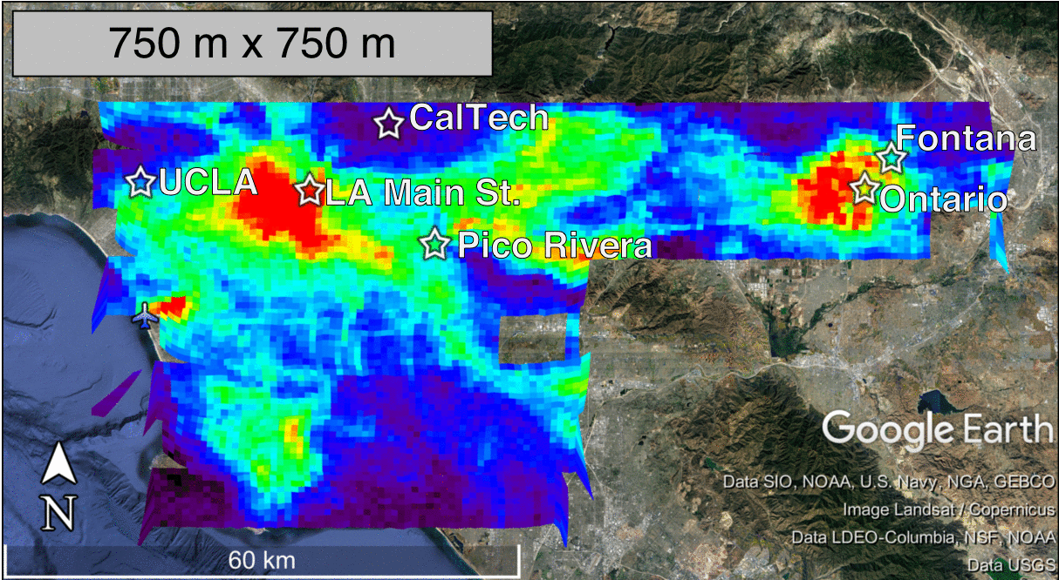
Upscaling GeoTASO NO₂ Rasters
LA Basin: June 26th AM
Our raster sampling strategy allows us to make ‘maps’ of the areas sampled at the current/expected spatial resolution for space-based retrievals.
This allows us to:
Visualize what different spatial features look like at varying pixel sizes – can be applied to actual footprints of the space-based platforms
Test validation strategies for column-to-column comparisons while also keeping information about the sub-pixel variability for linking the local Pandora measurement to the larger spatial area of the space-based measurement
Notes:
Because of the gapless maps we created with GeoTASO, we are able to bin the data to mimic the spatial footprint of TEMPO, TROPOMI, and OMI. These maps show LA and the plume extending from the pleasant prarie power plant in rural Wisconsin at the 750m resolution from GeoTASO and then GeoTASO binned up to the 4.4km x 2.1km footprint expected for TEMPO NO2.
We can see at many of the features are still conserved at this level. With this data, we can then test what we can expect to see from a network of Pandora’s.

Slide 9
Upscaling GeoTASO NO₂ Rasters
LA Basin: June 26th AM
Sizes for sensor comparison were chosen as the closest to the areal resolution of near-nadir observations
TEMPO: 4.4 km x 2.1 km : 9.24 km² → 3 km x 3 km : 9 km²
TROPOMI: 3.5 km x 7 km : 24.5 km² → 5 km x 5 km : 25 km²
OMI: 24 km x 13 km : 312 km² → 18 km x 18 km : 324 km²
Upscaled pixels must have been at least 50% sampled by GeoTASO
Notes:
Because of the gapless maps we created with GeoTASO, we are able to bin the data to mimic the spatial footprint of TEMPO, TROPOMI, and OMI. These maps show LA and the plume extending from the pleasant prarie power plant in rural Wisconsin at the 750m resolution from GeoTASO and then GeoTASO binned up to the 4.4km x 2.1km footprint expected for TEMPO NO2.
We can see at many of the features are still conserved at this level. With this data, we can then test what we can expect to see from a network of Pandora’s.

Slide 10
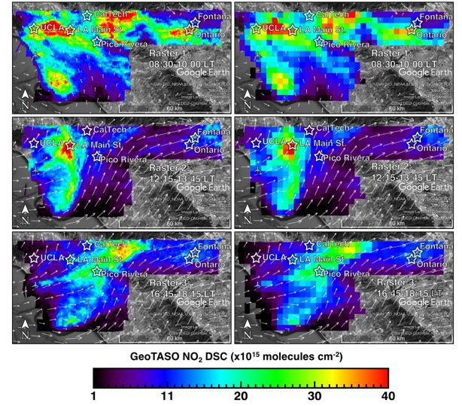
Upscaling GeoTASO NO₂: Native vs TEMPO resolution
750m x 750m
3km x 3km (approx. TEMPO native pixel area)
08:30-10:00 LT
08:30-10:00 LT
12:15-13:45 LT
12:15-13:45 LT
16:45-18:15 LT
16:45-18:15 LT
Notes:
Maps of GeoTASO NO₂ DSCs over the LA Basin on June 27th, 2017. Raster 1 from 08:30-10:00 LT is shown in a and b, Raster 2 from 12:15-13:45 LT is shown in c and d, and Raster 3 from 16:45-18:15 LT is shown in e and f. Panels a, c, and e are at 750 m x 750 m resolution, whereas b, d, and f are the DSCs binned to 3 km x 3 km spatial resolution. Overlaid are the boundary layer averaged wind vectors from the NAM-CONUS 3-km nest analysis for 16:00 UTC (09:00 LT) in a and b, 20:00 UTC (13:00 LT) in c and d, and 00:00 UTC (17:00 LT) in e and f.
We can see at many of the features are still conserved at this level. With this data, we can then test what we can expect to see from a network of Pandora’s.

Slide 11
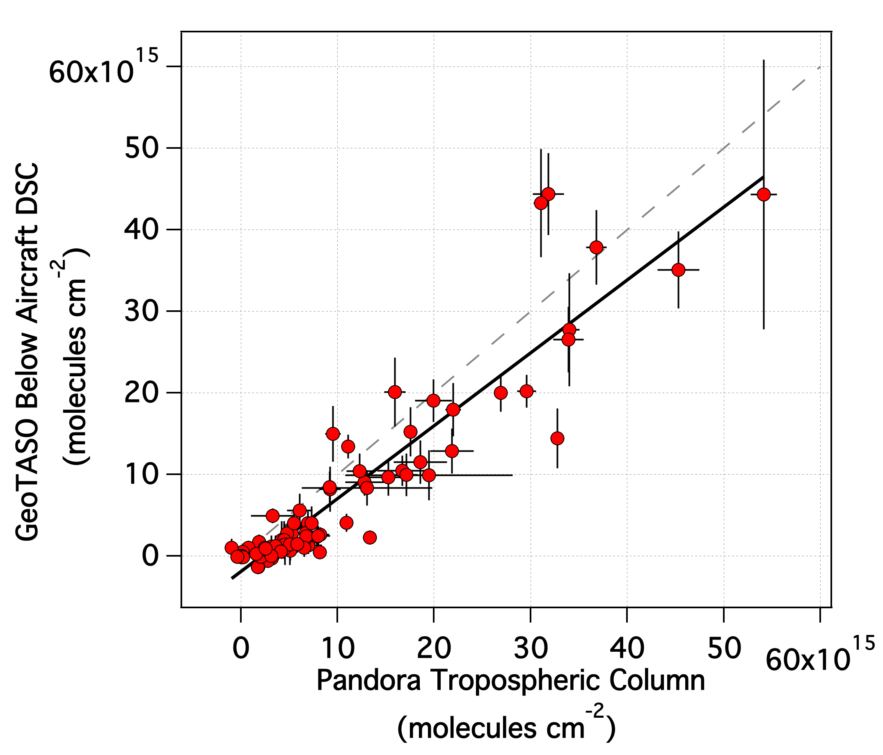
750 m x 750 m
GeoTASO Nominal
3 km x 3 km : 9km²
TEMPO
y=0.99x-2.4x10¹⁵
r²=0.86
n=87
y=0.89x-1.9x10¹⁵
r²=0.86
n=87

Slide 12
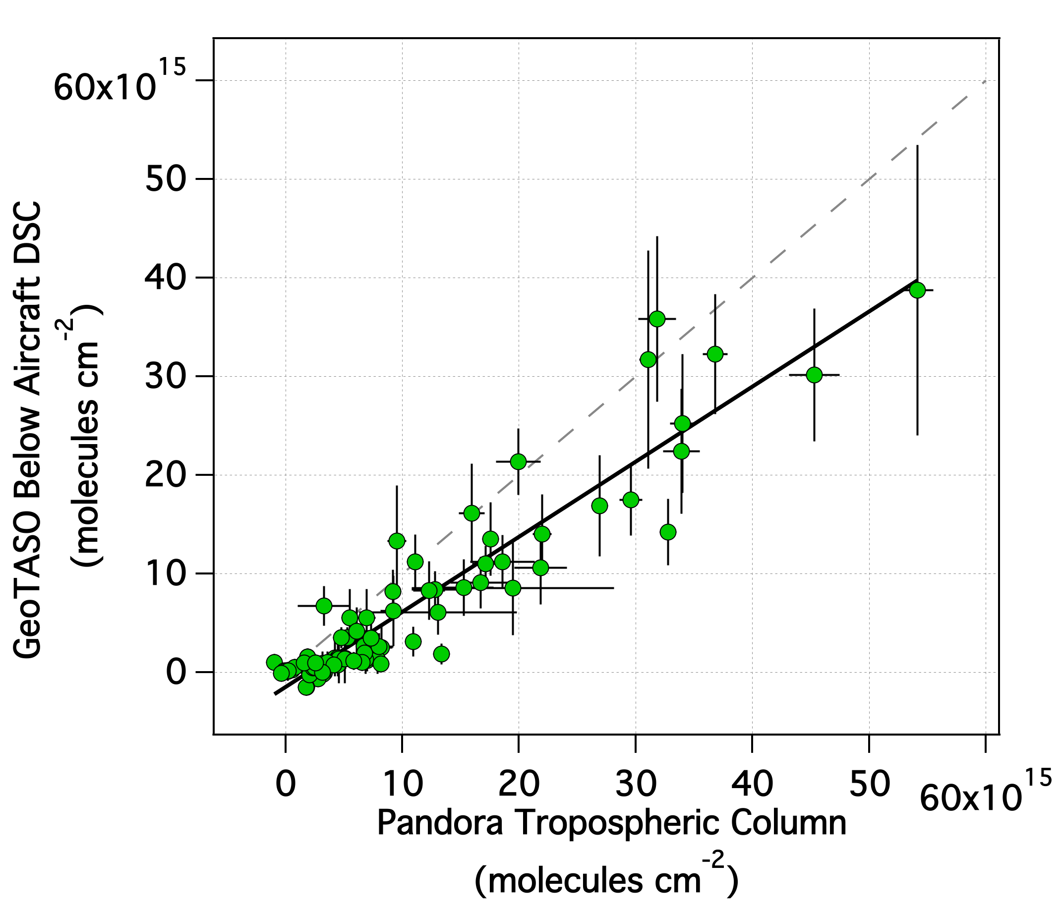
750 m x 750 m
GeoTASO Nominal
5 km x 5 km : 25km²
TROPOMI
y=0.99x-2.4x10¹⁵
r²=0.86
n=87
y=0.76x-1.5x10¹⁵
r²=0.88
n=87

Slide 13
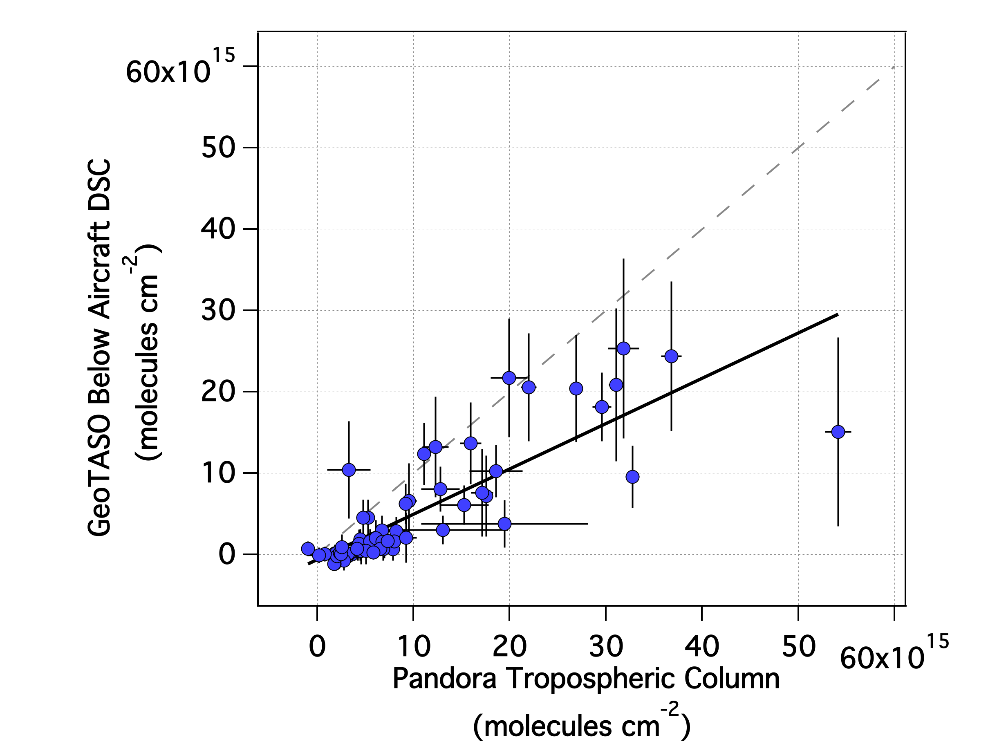
750 m x 750 m
GeoTASO Nominal
18 km x 18 km : 324km²
OMI
Schiller Park
O’Hare Airport
June 1st
CalTech
June 26th
y=0.99x-2.4x10¹⁵
r²=0.86
n=87
y=0.56x-6.4x10¹⁴
r²=0.69
n=65

Slide 14
750 m x 750 m
GeoTASO Nominal
3 km x 3 km : 9km²
TEMPO
5 km x 5 km : 25km²
TROPOMI
18 km x 18 km : 324km²
OMI
Schiller Park
O’hare Airport
June 1st
CalTech
June 26th
y=0.99x-2.4x10¹⁵
r²=0.86
n=87
y=0.89x-1.9x10¹⁵
r²=0.86
n=87
y=0.76x-1.5x10¹⁵
r²=0.88
n=87
y=0.56x-6.4x10¹⁴
r²=0.69
n=65
Correlation is preserved at the areal resolutions of TEMPO and TROPOMI
Slope decreases as spatial resolution is coarsened
Correlation and number of coincidences significantly decreased at OMI spatial resolution

Slide 15
Looking ahead…
Satellite Validation: These airborne measurements provide a transfer standard between Pandora measurements (high temporal resolution but possibly influenced by very local scale phenomena) and satellite measurements (providing information on sub-pixel variability)
Manuscript in preparation about these Pandora comparison statistics in relation to spatial resolution
Data from summer 2017 LMOS and SARP flights will be publicly available after June 2018
Additional work needed to generate vertical columns from these slant columns (need a priori information at comparable spatial resolution)
Participation in Long Island Sound Tropospheric Ozone Study (LISTOS) summer 2018
Diurnal sampling of NYC
Coincidences with TROPOMI for contribution to Sentinel-5 Precursor (TROPOMI) validation
Looking at pollution transport over Long Island Sound into the downwind States

Slide 16
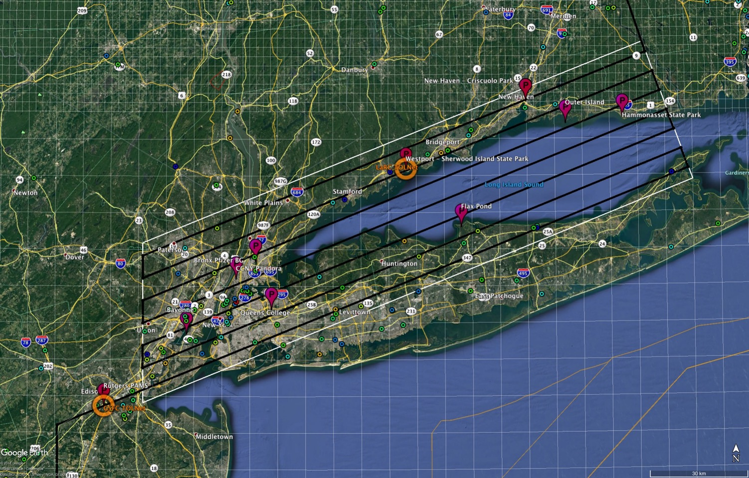
LISTOS v1 NASA raster (28,000 ft altitude): black=nadir track, white=swath extent)
Colored circles: eGRID 2016 total ozone season NOx emissions in tons, log scale from 1 ton/yr (blue) to 1000 tons/yr (red)

Slide 17
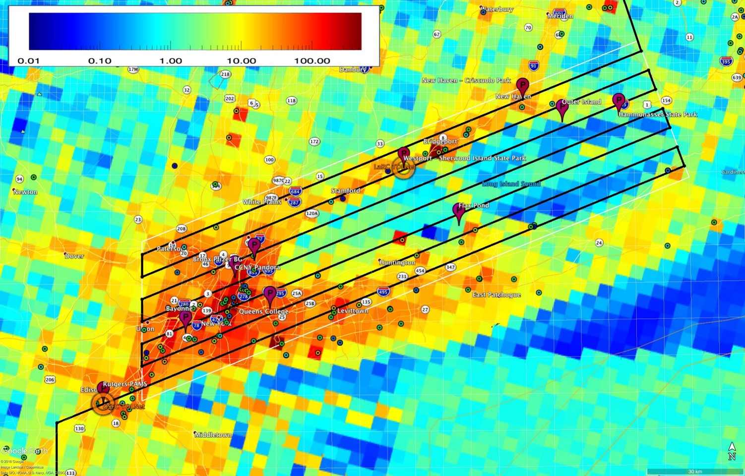
Base layer 4km EPA OAQPS Research June 2016 emissions (courtesy Alison Eyth, Luke Valin, US EPA and Laura Judd, NASA)

Slide 18
Backup Slides

Slide 19
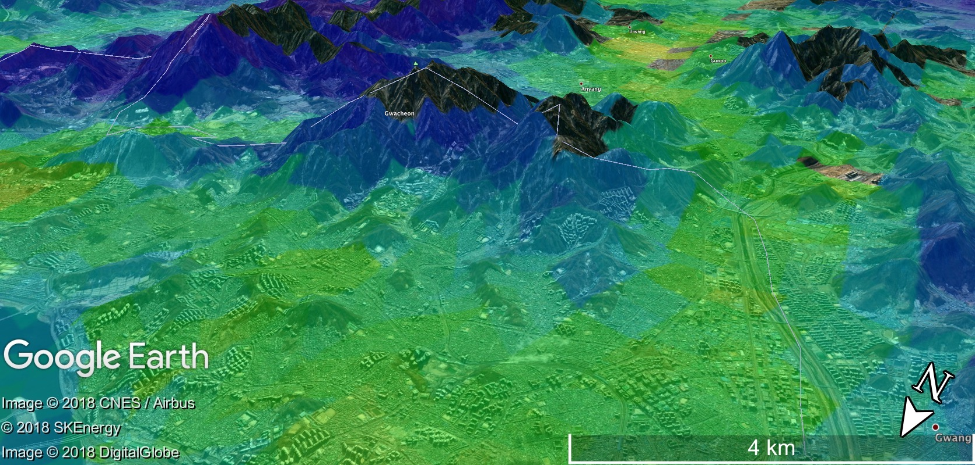
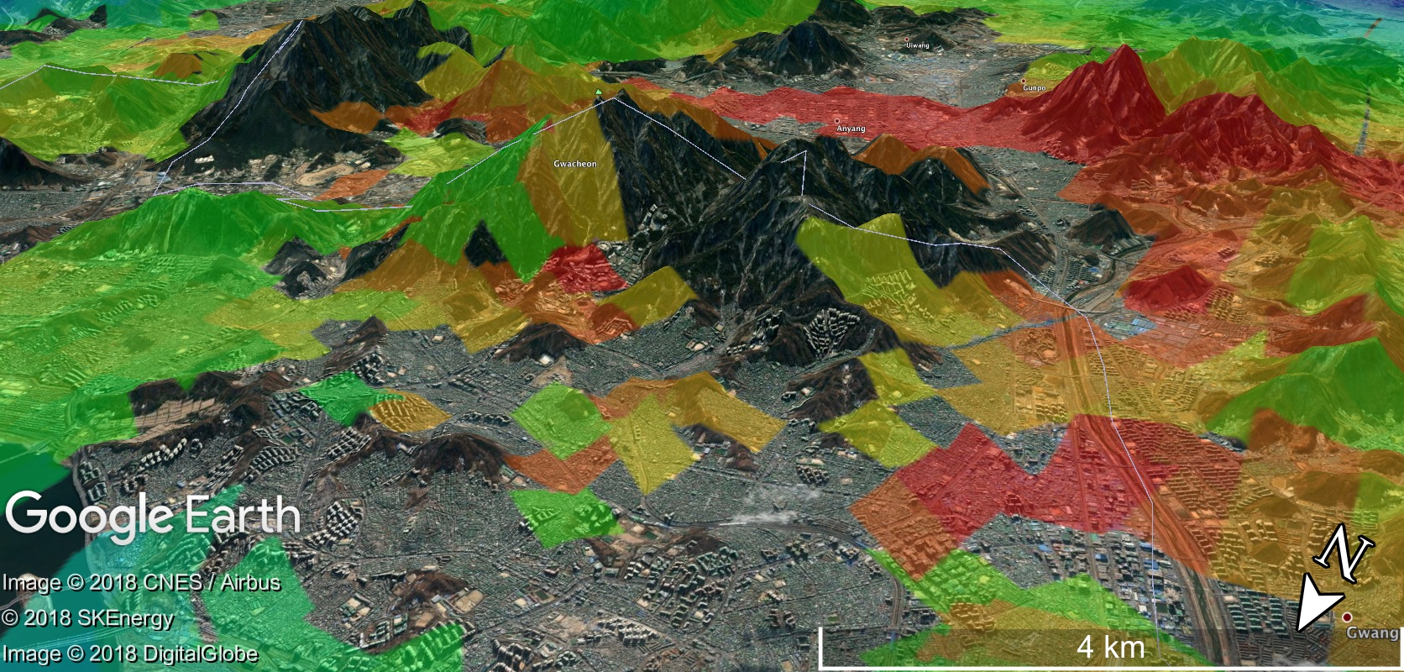
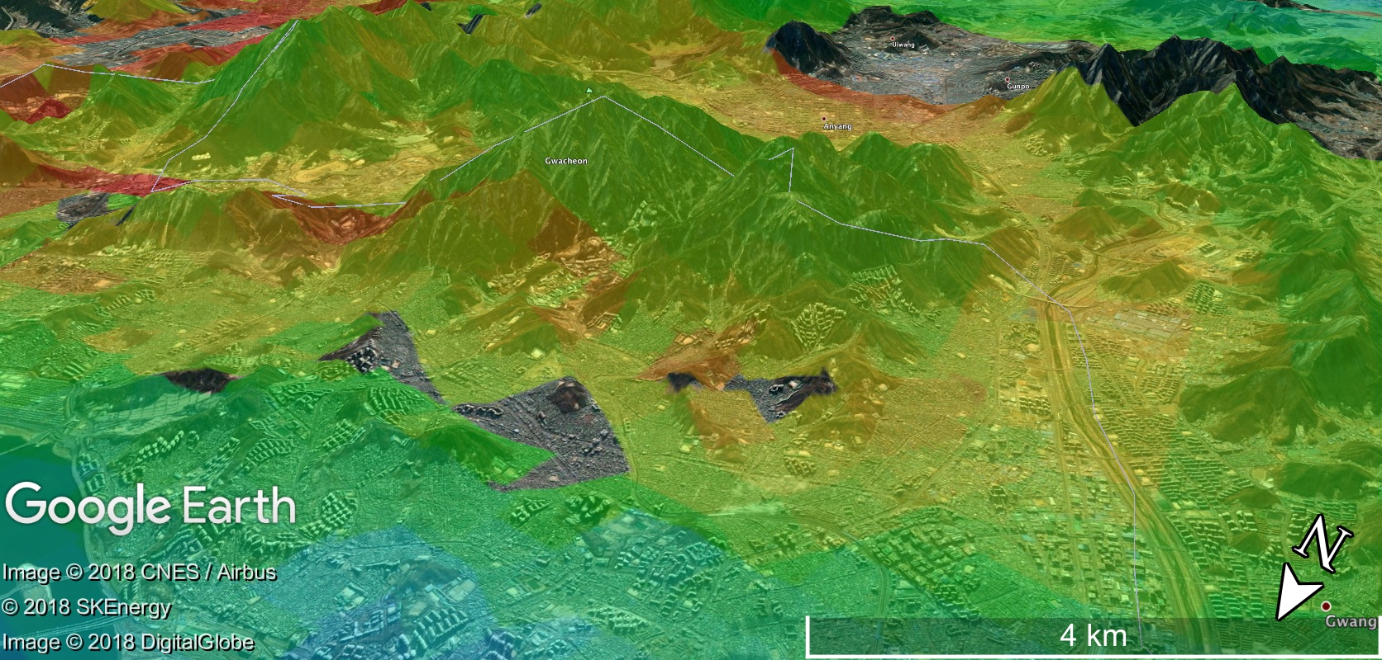
Seoul: June 9th, 2016 → Influence of terrain on spatial patterns
Raster 1: 8-10AM
Raster 2: 10AM-Noon
Raster 3: 2-4 PM
Raster 4: 4-6 PM
Clouds likely

Slide 20
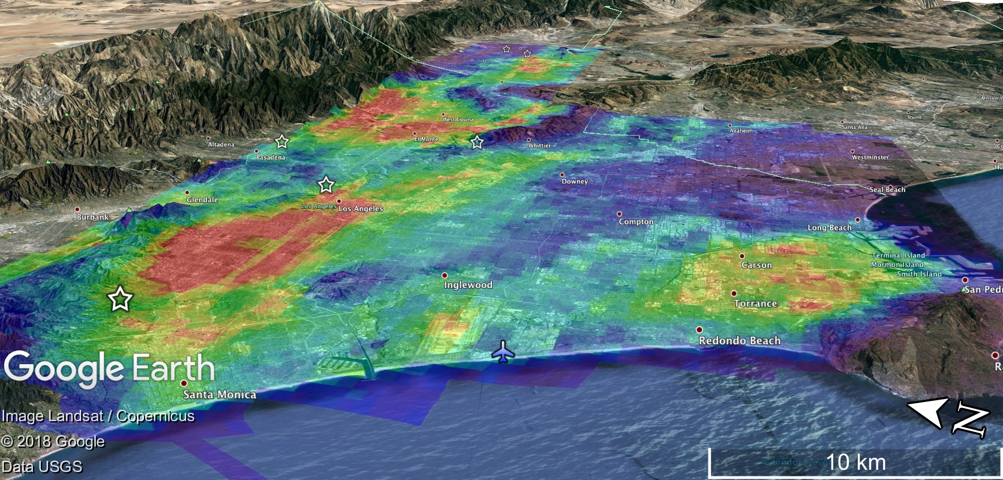
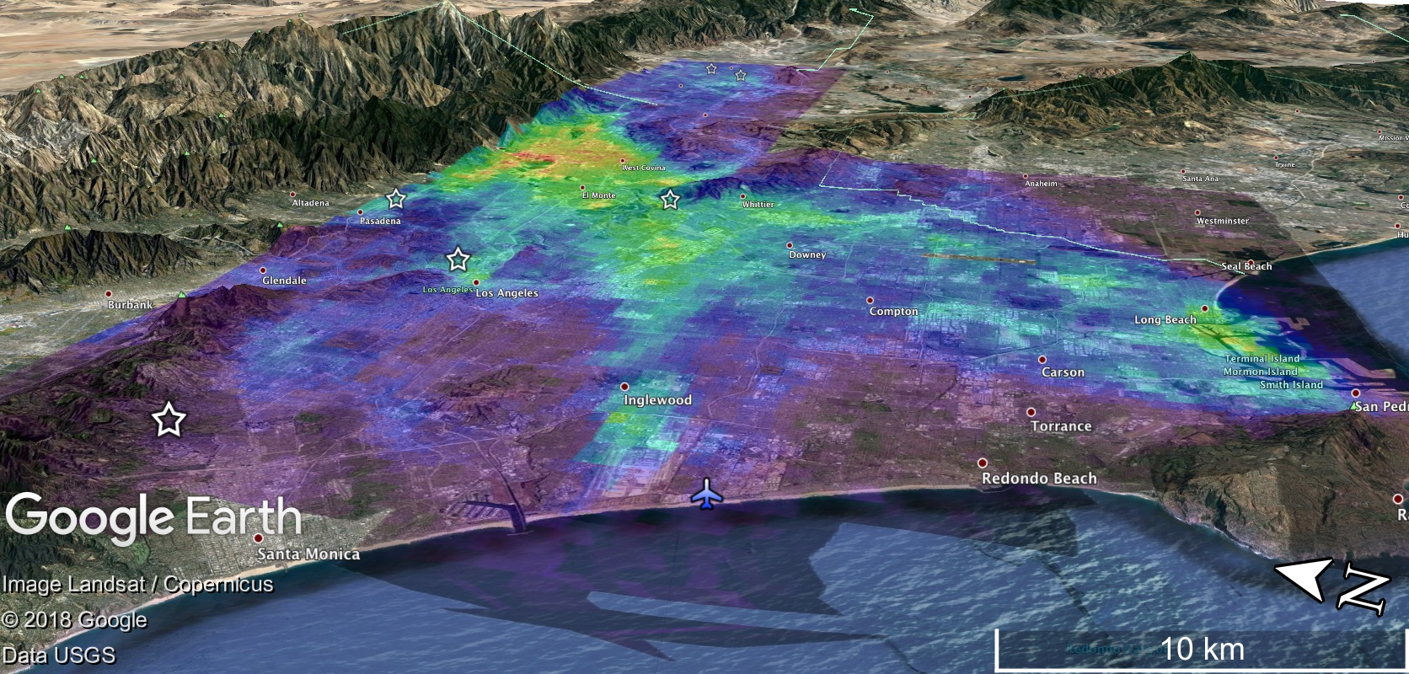
Los Angeles: June 27th, 2017 → Influence of terrain on spatial patterns
Raster 1: 8:30-10AM
Raster 2: 12:15-01:45PM
Raster 2: 04:45-06:15PM

Slide 21
Stratospheric Subtraction
Ref_Sun
Obs_Sun
Stratospheric NO₂ vertical column estimated by the PRATMO Chemical Box Model and multiplied by sec (SZA) to convert to a SC
Stratosphere
Always a presence of NO₂ in the stratosphere. This vertical column amount can be measured or estimated.
The bigger the difference in sun angle between reference and observation will amount to a larger difference in the stratospheric slant column within the DSC.
GeoTASO
And the DSC is the difference between the observed column to the reference spectrum.
Reference column doesn’t have significant pollution in the troposphere.
Troposphere
Pandora
${GTASO SC}_{T}=DSC−[{Strat SC}_{Obs}−{Strat SC}_{ref}]$
$${Pandora SC}_{T}=( VC × AMFPAN)−({VC}_{strat} × AMFPAN)$$

Slide 22
L1B spectra: Spatially bin to ~ 250m x 250m pixels
Retrieve NO₂ Differential Slant Columns (DSCs) relative to an unpolluted reference spectrum taken in flight with QDOAS in the 435-460 nm window
Estimate and subtract difference in stratospheric slant column between reference and observation time: (OMI, OMPS, Pratmo Climatology)
${DSC}_{T}=DSC−{Strat}_{VC} [\sec\left(SZA\right)−\sec\left({SZA}_{REF}\right)]$
Bin data spatially to 750m x 750m pixels: Decreases noise approximately 50%
Spatially upscale to desired spatial resolution (e.g. 3 km x 3 km for TEMPO, 5 km x 5 km for TROPOMI, or 18 km x 18 km for OMI)
Calculate and apply AMFs to derive VCs
[Future Work]
LMOS AMFs a priori 4-km WRF-Chem Output from U. Iowa (stratospheric supplement from RAQMS and Pratmo), MODIS BRDF,

Slide 23
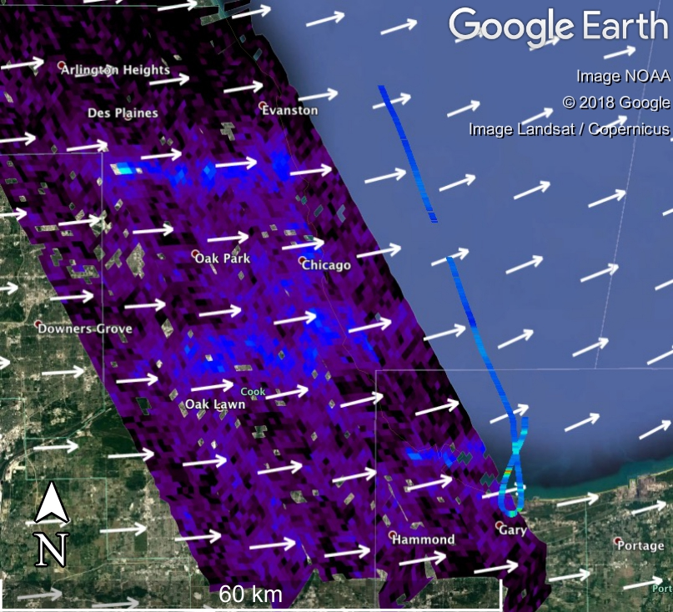
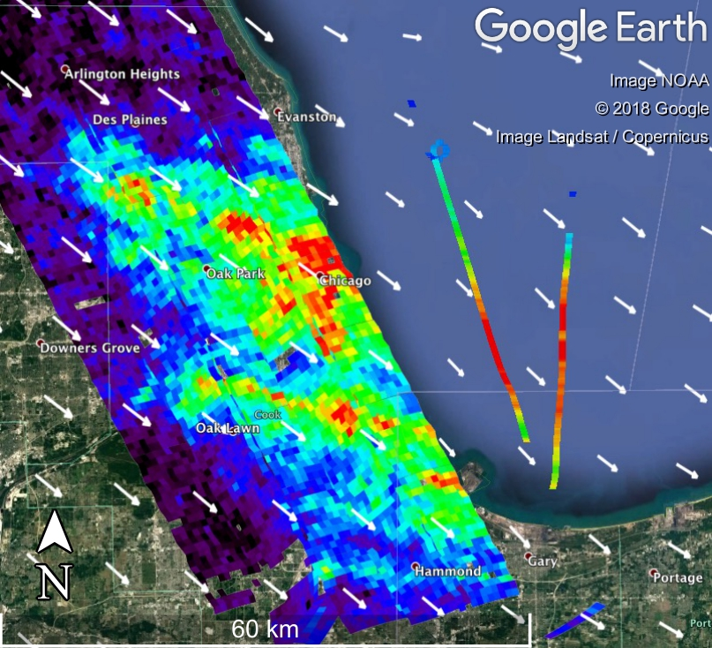
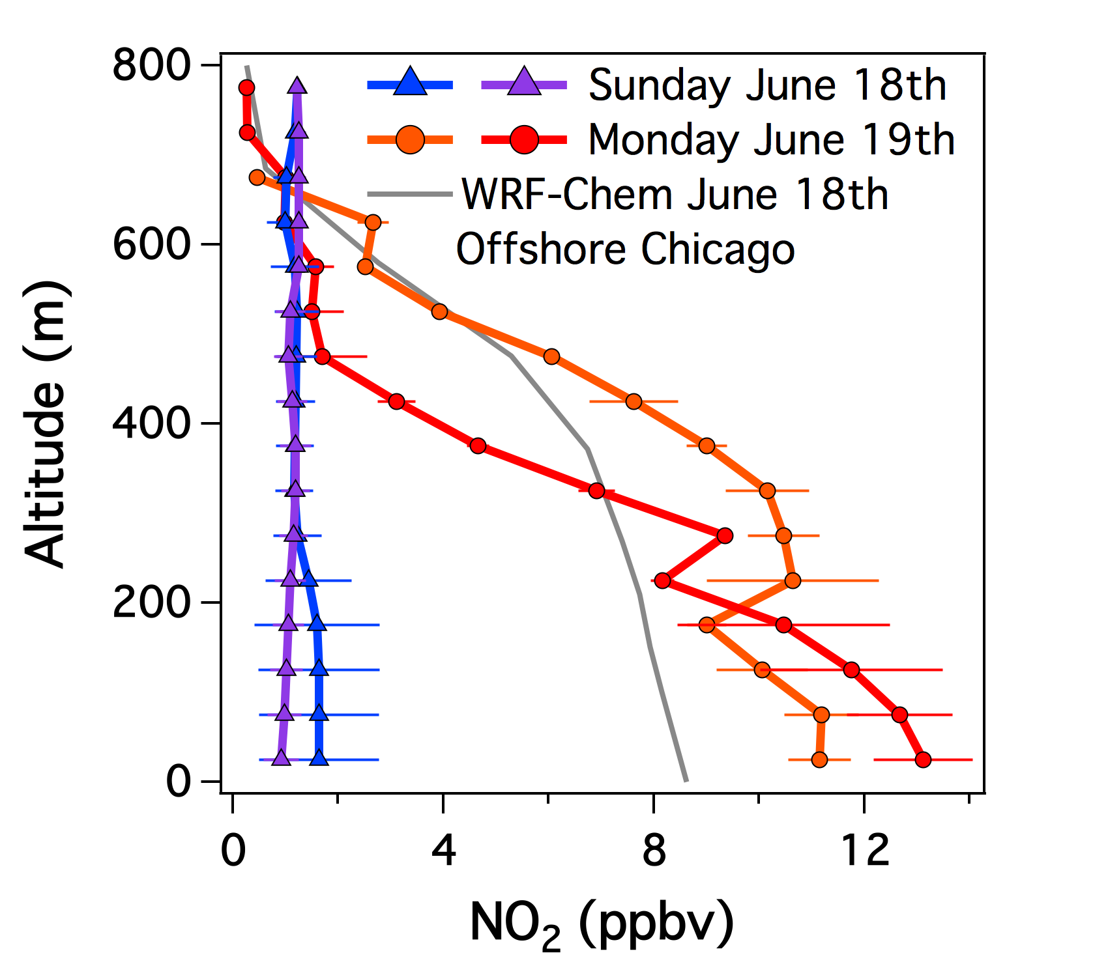
Day-to-day variability: Weekend vs. Weekday
Sunday, June 18th, 2017
Monday, June 19th, 2017
Measured 0-1km Column Density
Total AMF : Below Aircraft AMF
2.20x10¹⁵ molecules cm⁻²
1.31 : 0.62
2.53x10¹⁵ molecules cm⁻²
1.29 : 0.64
10.6x10¹⁵ molecules cm⁻²
1.13 : 0.86
13.3x10¹⁵ molecules cm⁻²
1.15 : 0.93
WRF-Chem June 18th Profile:
10.8x10¹⁵ molecules cm⁻²
1.17 : 0.90
In situ NO₂ (ppbv)
0
3
6
9
12+
Raster occurred from 08:00-10:00 AM with Scientific Aviation flying near the end of the GeoTASO overpass

